Slide 1

Placement 1: Evolving M. australicum to utilise ICEs for nitrogen-fixing symbiosis with Lotus legumes
Isaak Salami, 46625143
Isaak Salami, 46625143

Slide 2
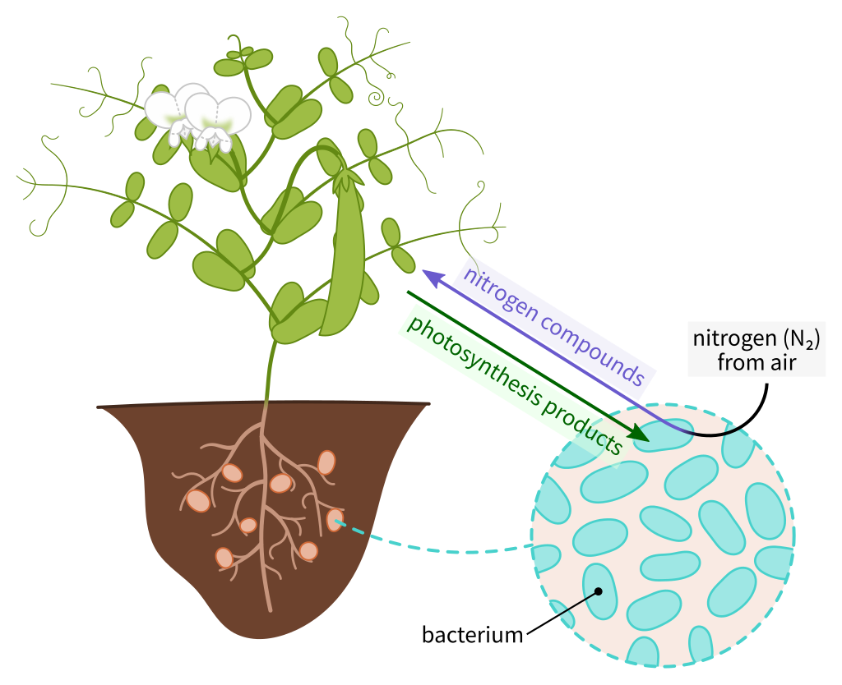
Background: Legumes, rhizobia and ICEs
Symbiosis between soil bacteria (rhizobia) and legumes is defined by two main characteristics:
Nodules on the legume roots (Oldroyd)
Rhizobia fix atmospheric N₂ into bioavailable the nitrogen (NH₃) which acts as an organic fertilizer for the host legume (Oldroyd
Integrative and conjugative elements (ICE): Genetic elements that can shuttle genes between bacteria via conjugation (Johnson)
Acquisition of ICE carrying symbiosis and nitrogen-fixing genes, ICESyms, can evolve non-symbiotic Mesorhizobia into a symbiont of legumes (Colombi)
A diagram displaying rhizobia symbiosis with a legume. Image credit: Nefronus, (WikiMedia Commons).
Isaak Salami, 46625143

Slide 3
Project Scope: M. australicum BR1-1-5xICEMlSym and Lotus legumes
Dr Colombi’s project goal: Evolve M. australicum BR1-1-5xICEMlSym into an effective symbiont of Lotus species
Placement project goal: Establish baseline symbiosis with various Lotus species prior to the experiment
Approach
Inoculate Lotus species with M. australicum BR1-1-5xICEMlSym for future assessment
Harvest and assess previously-inoculated Lotus species
Nodulation assessment
Dry foliage weight assessment
Colony morphology assessment
Isaak Salami, 46625143

Slide 4
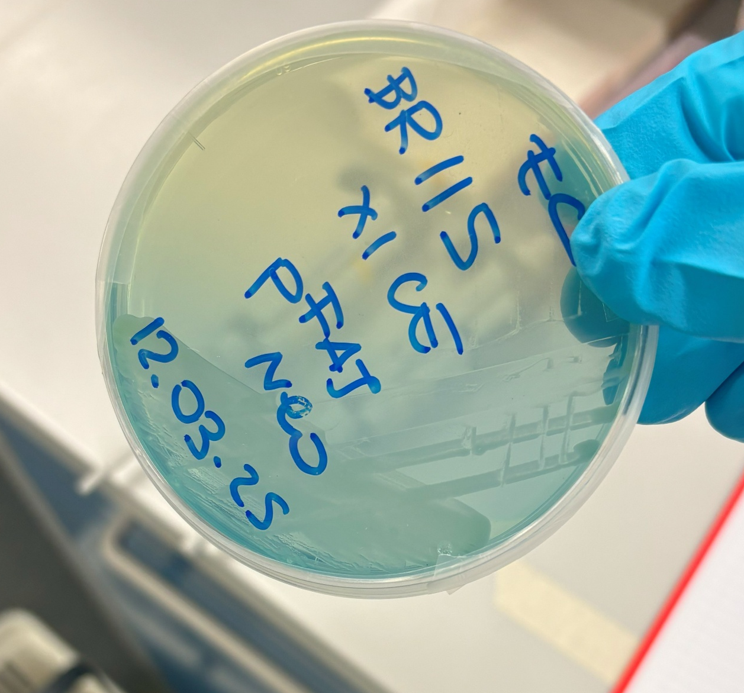
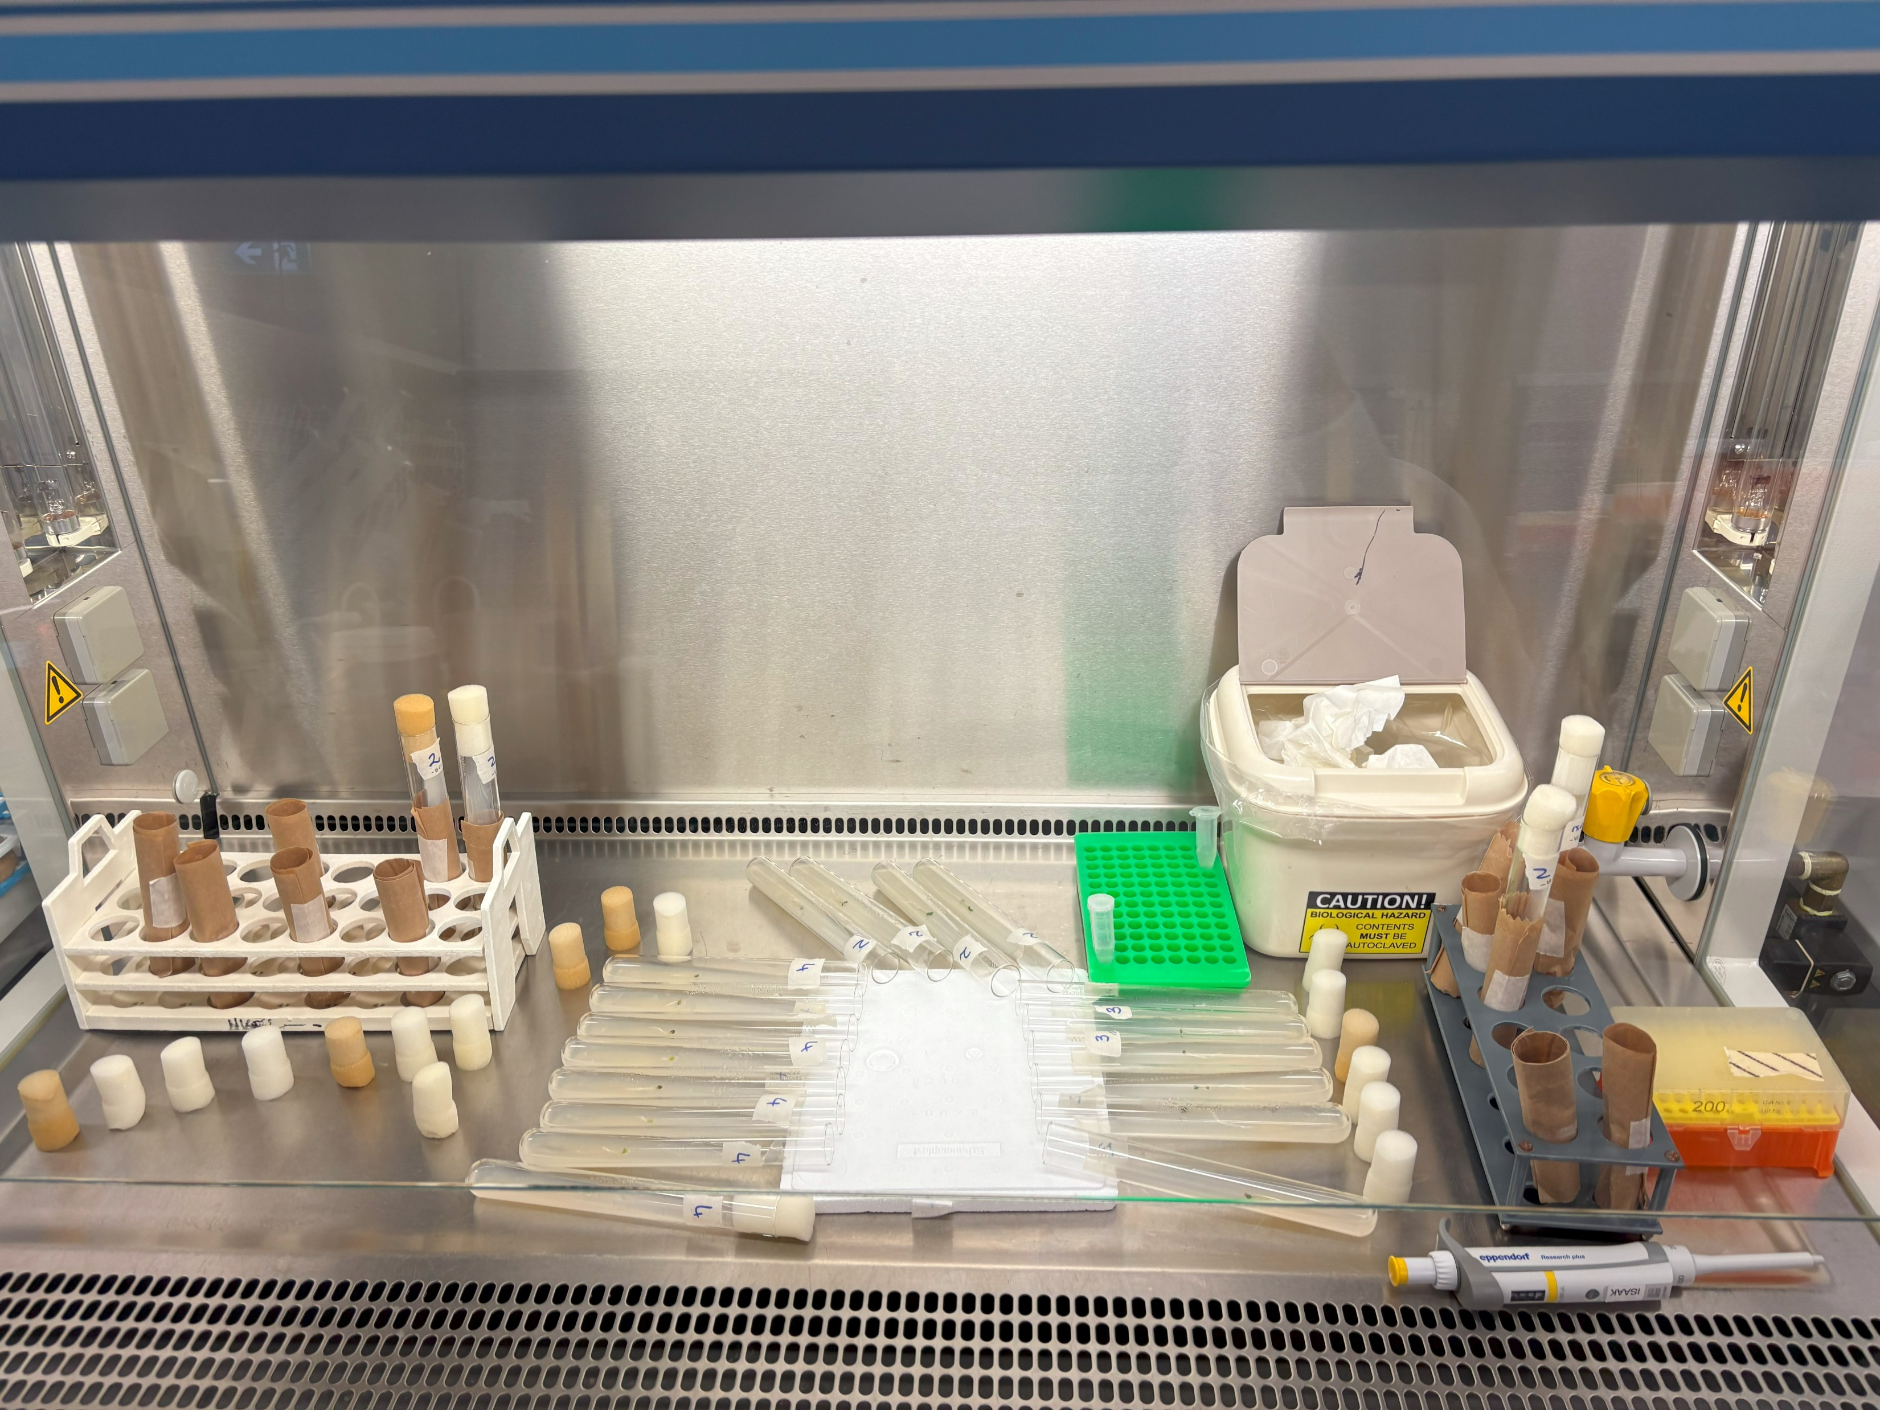
1. Inoculation
i. M. australicum BR1-1-5xICEMlSym colonies picked from G/RDM (no vit) and mixed into a suspension
ii. Successfully germinated Lotus seedlings were directly ionoculated with 20µL of M. australicum BR1-1-5xICEMlSym suspension
Isaak Salami, 46625143

Slide 5
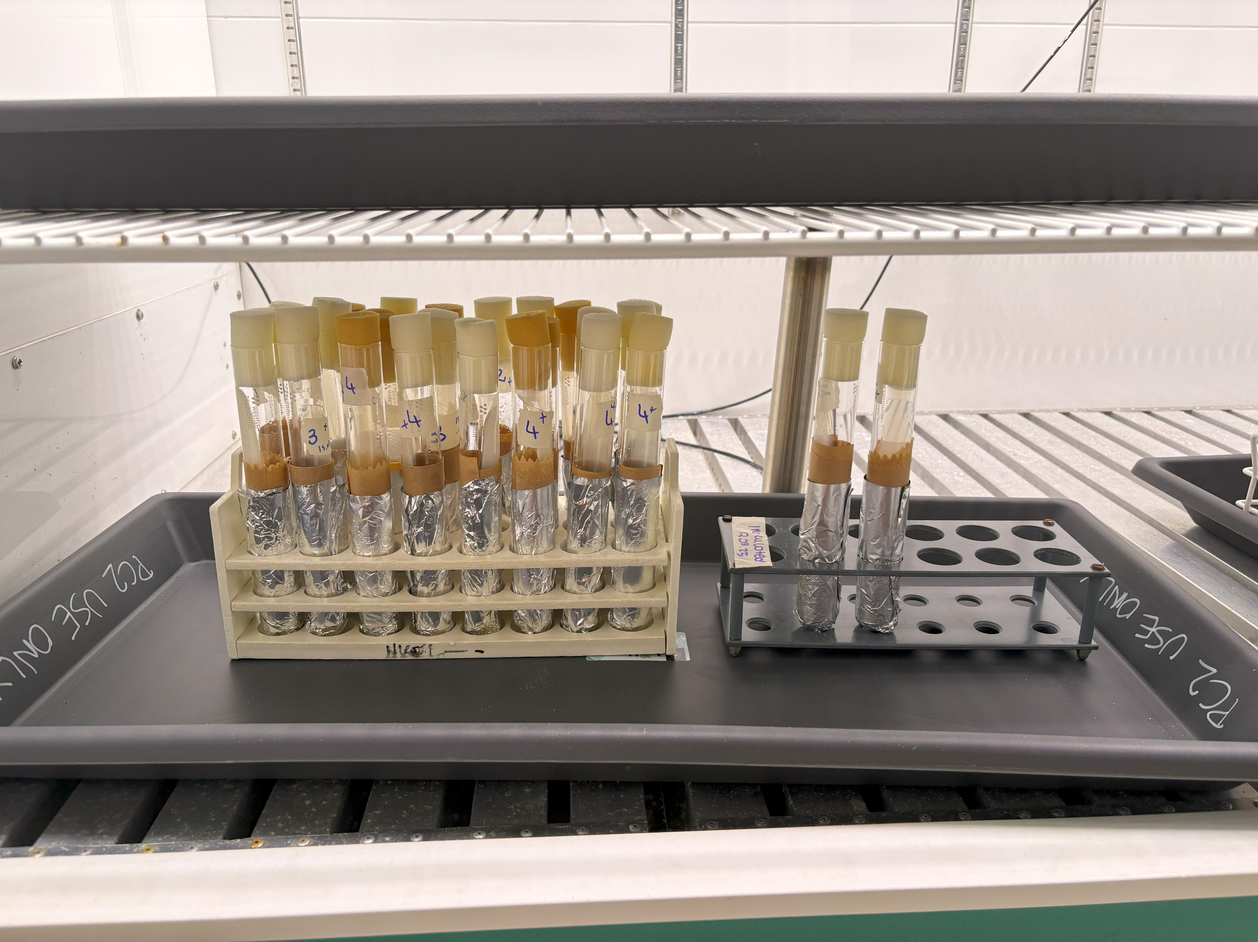
1. Inoculation
iii. Lotus inoculants moved to the PC2 CO2 chamber to incubate and grow for ⁓2 months
Isaak Salami, 46625143

Slide 6
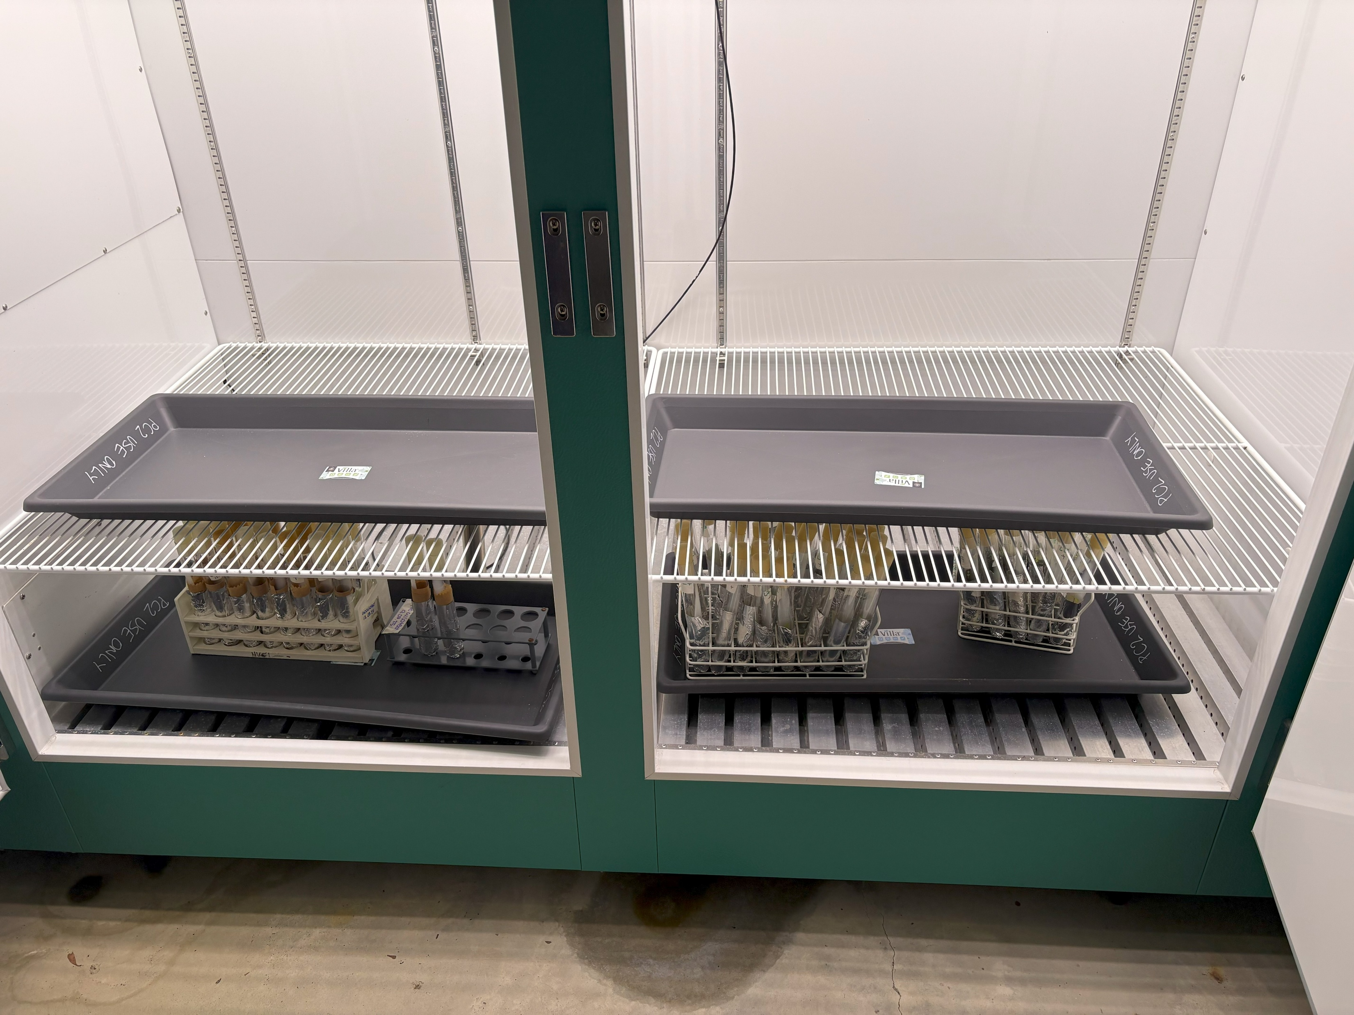
2. Harvest and Assessment
New L. australis and L. corniculatus inoculants
L. australis ID#3, L. uliginosus GLOC005 & L. rectus Tas2206 ready for harvest
Isaak Salami, 46625143

Slide 7
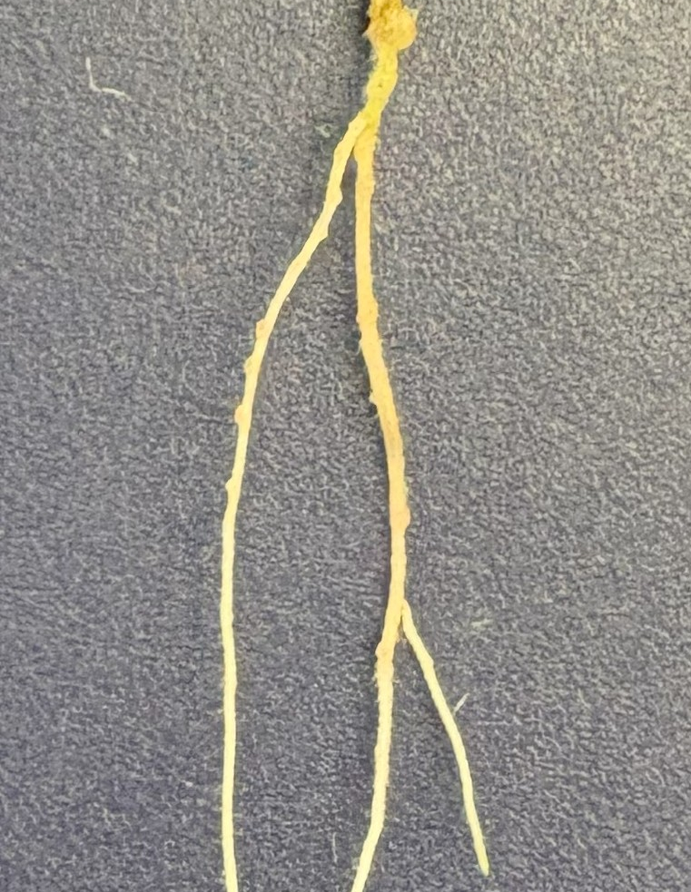
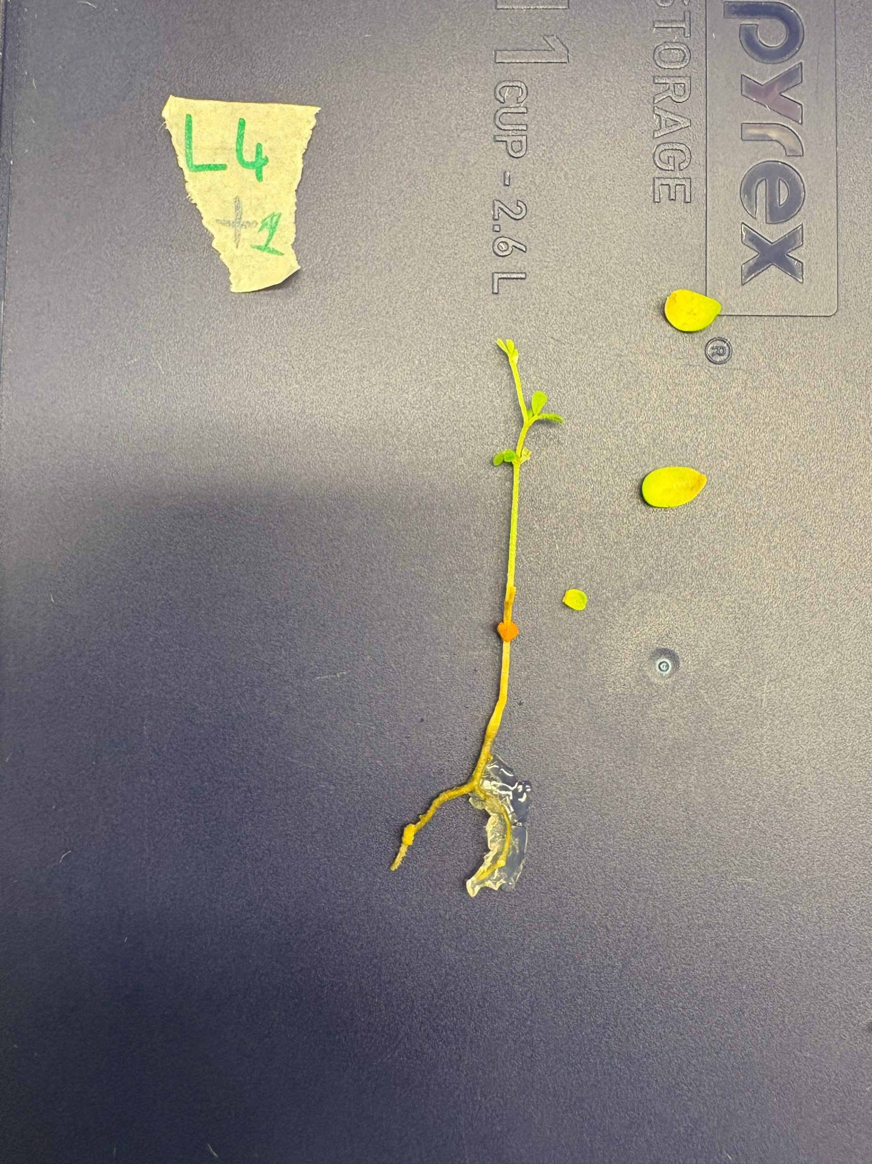
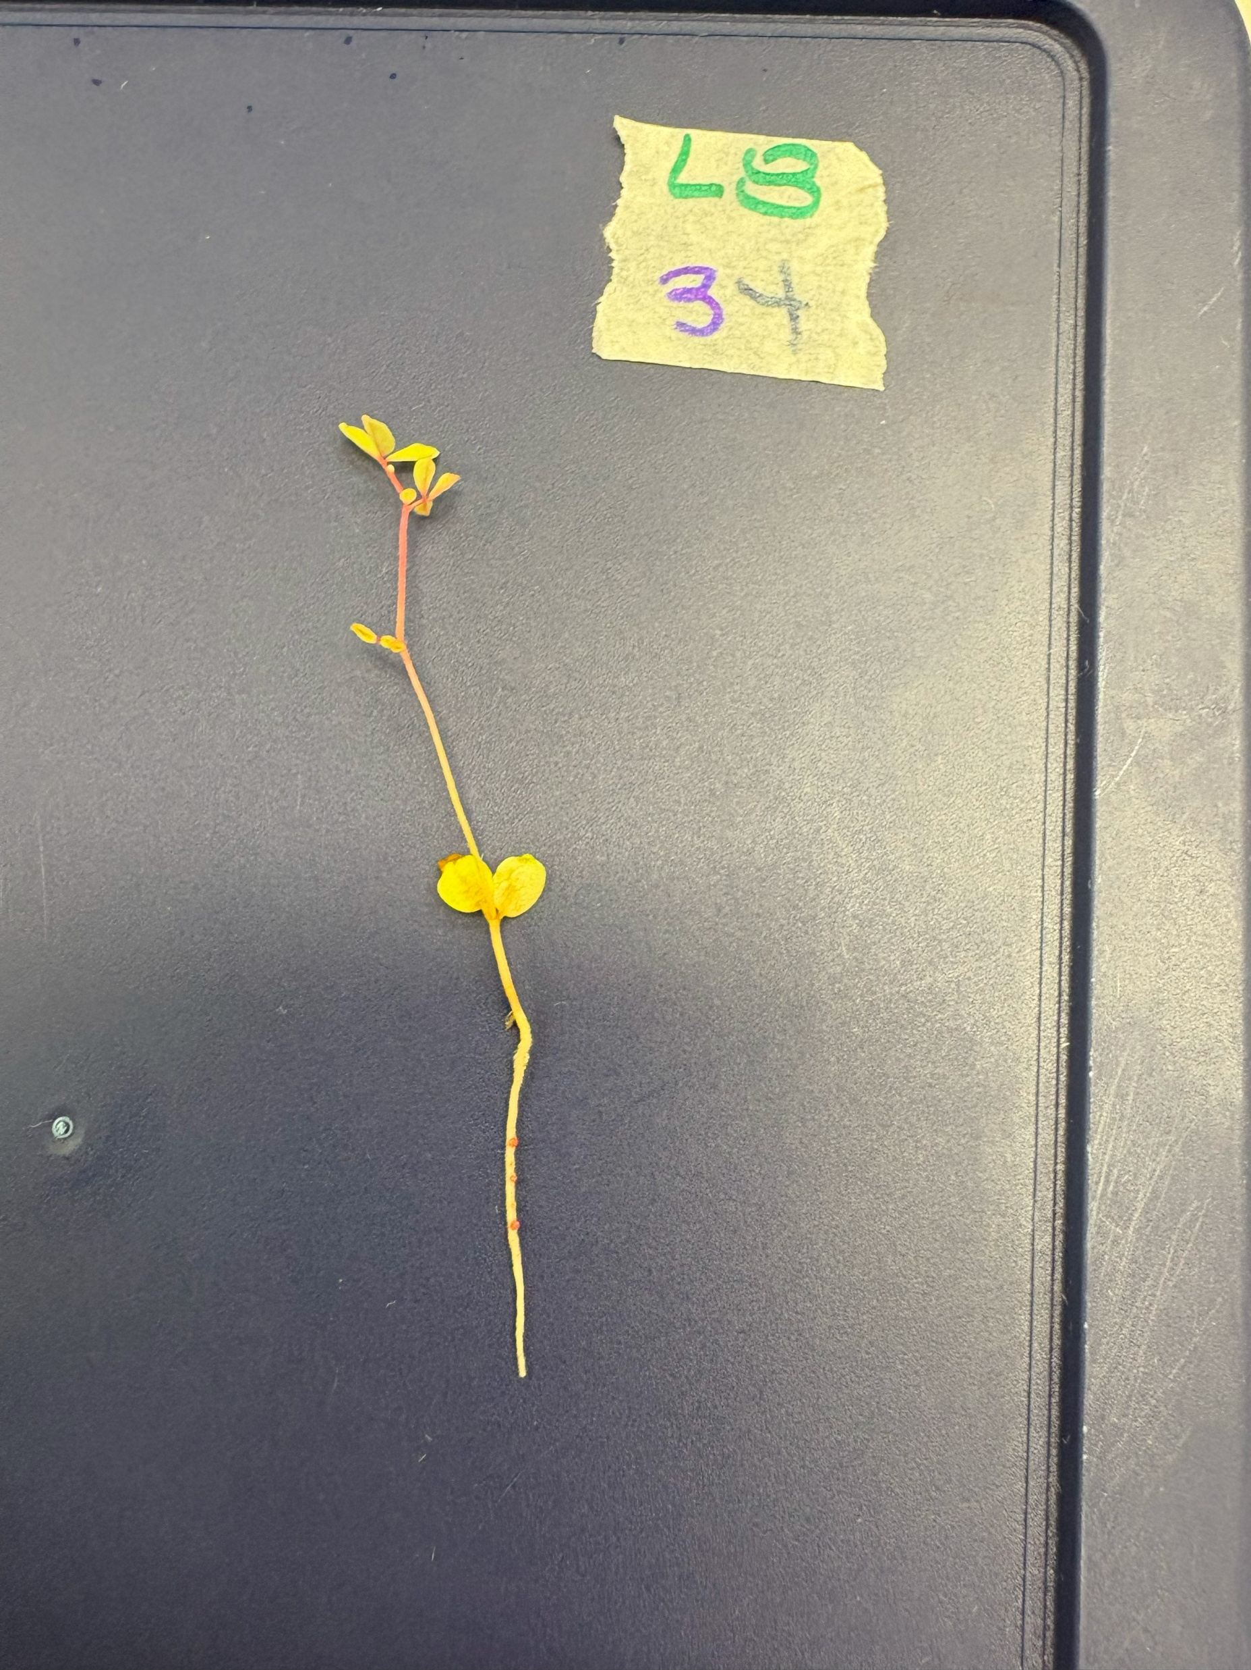
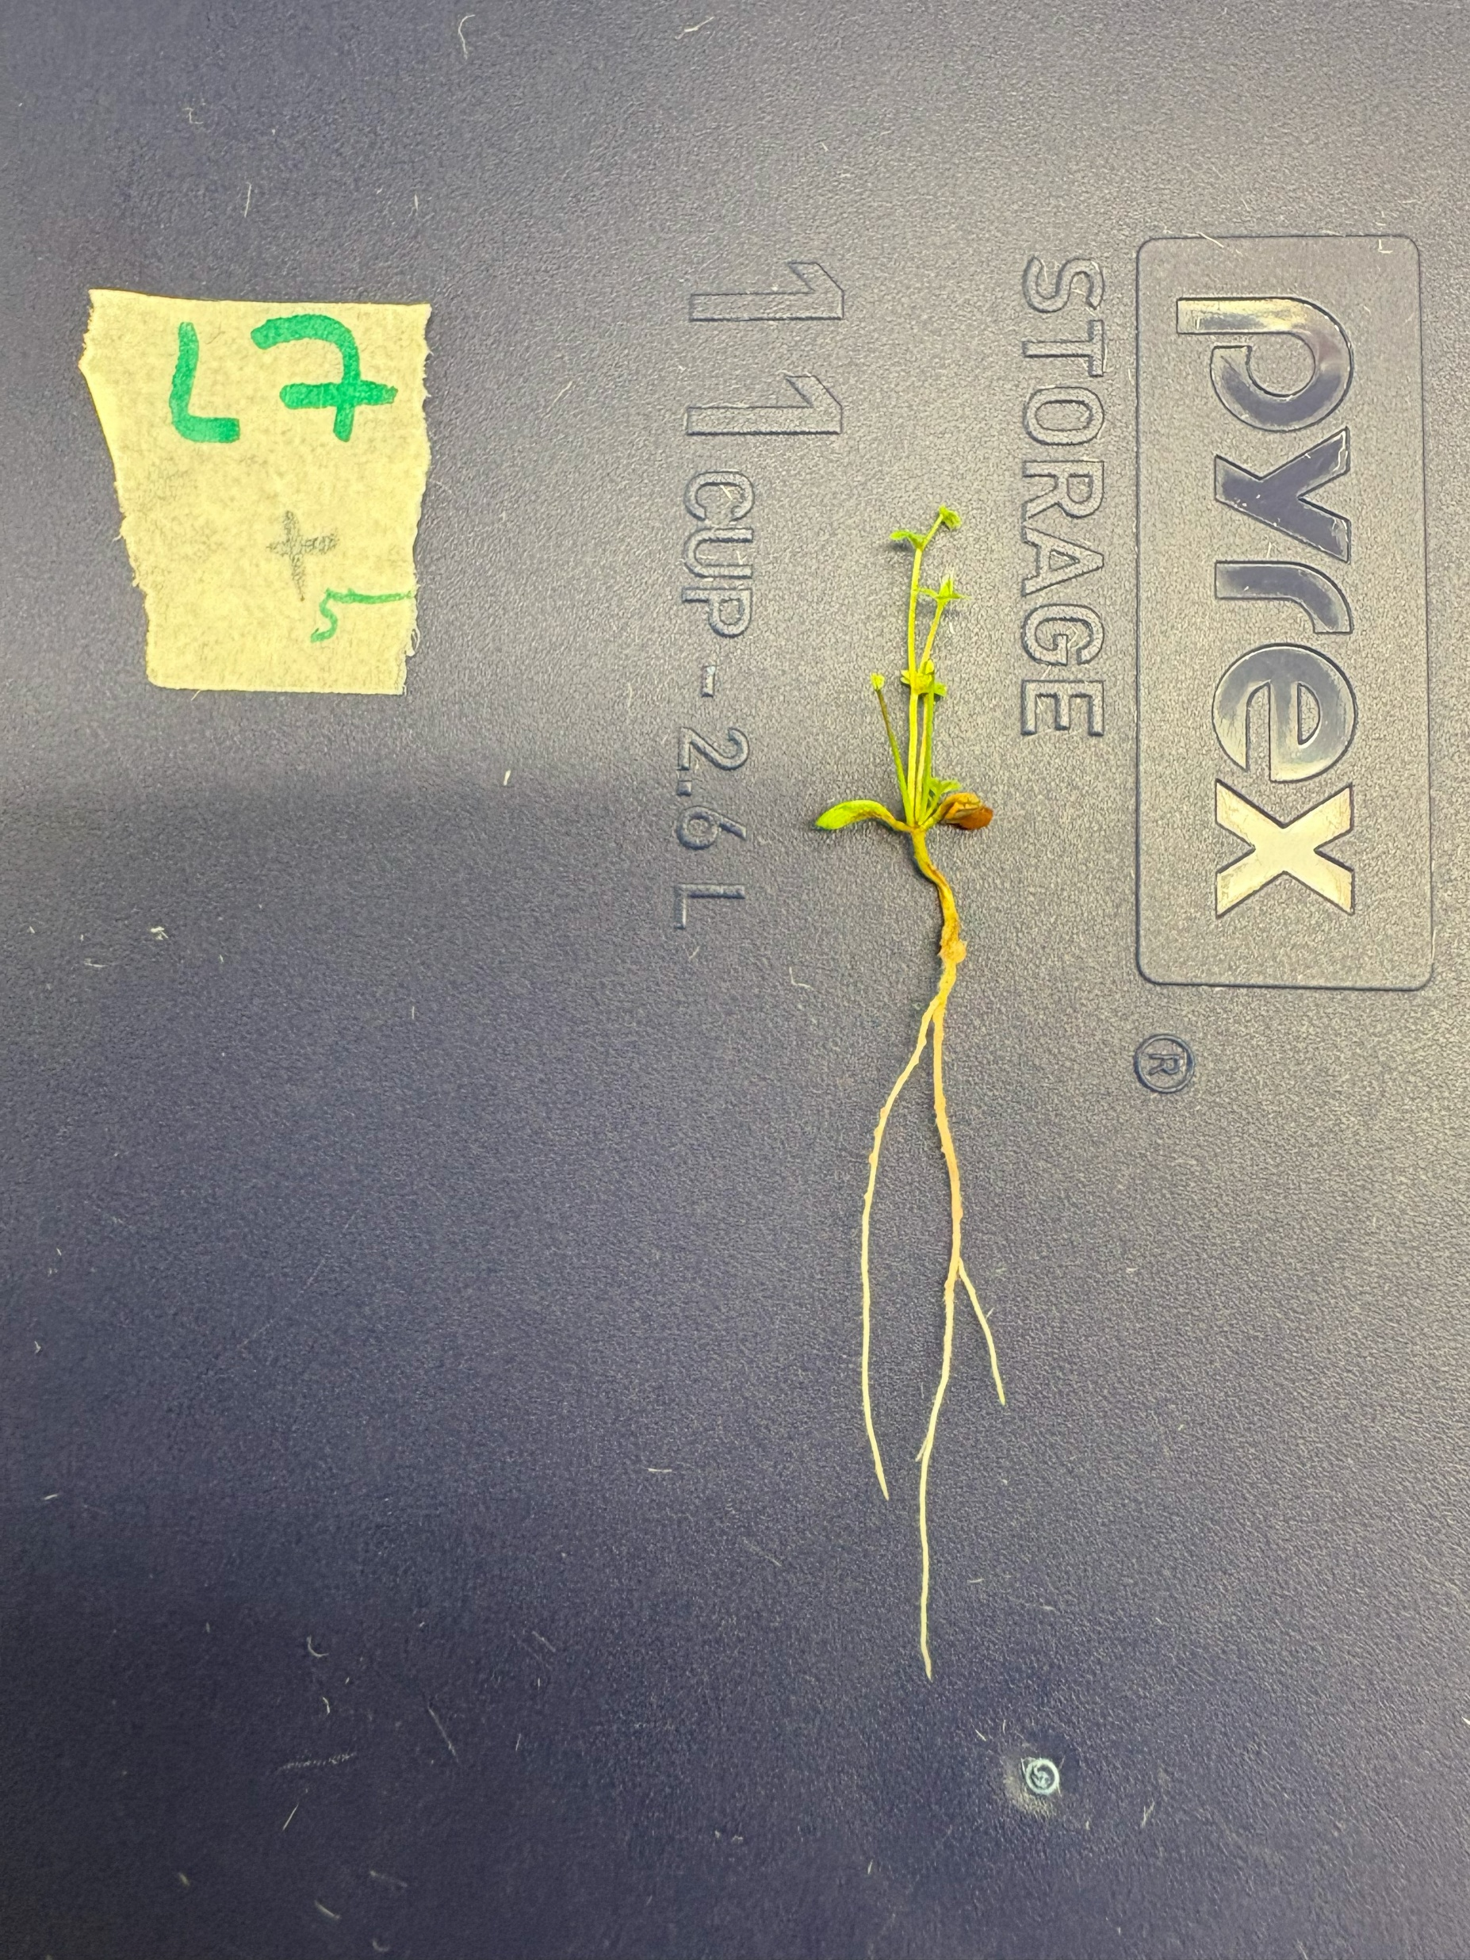
2a. Nodulation Assessment
L. rectus Tas2206,
subject L8+3
L. uliginosus GLOC005,
subject L7+5
L. Australis ID#3,
subject L4+1
Isaak Salami, 46625143

Slide 8
2b. Dry foliage weight assessment
One-Way ANOVA:
No significant interaction between nodulation state and dry foliage weight (F_{3,8} = 0.145, p = 0.9300)
Isaak Salami, 46625143

Slide 9
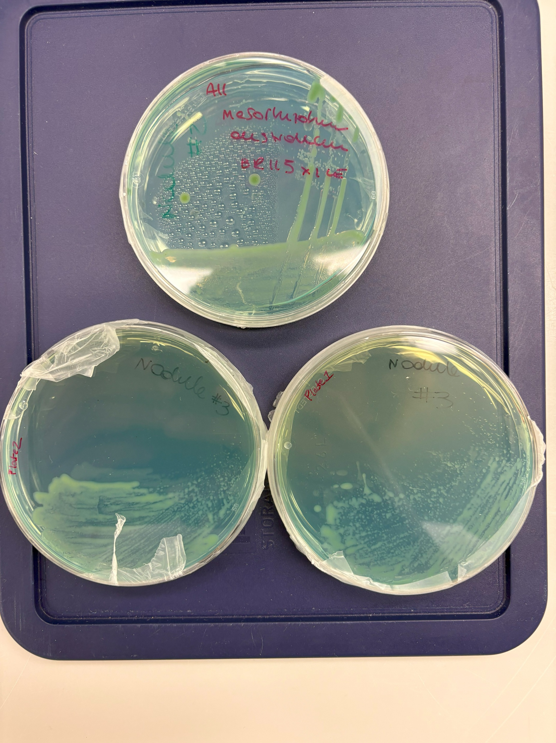
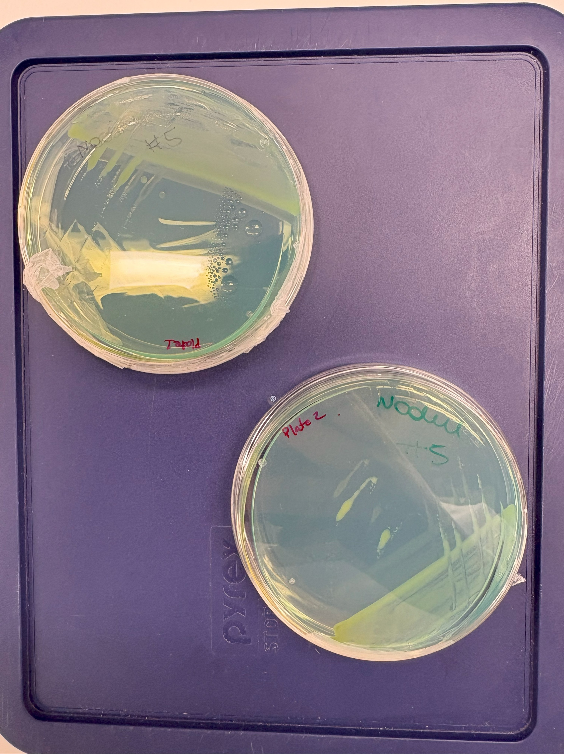
2c. Colony morphology assessment
Recovered isolates from L.rectus Tas2206 subjects L8+2 (top-left) L8+3 (bottom-left) and L8+5 (right)
Isaak Salami, 46625143

Slide 10
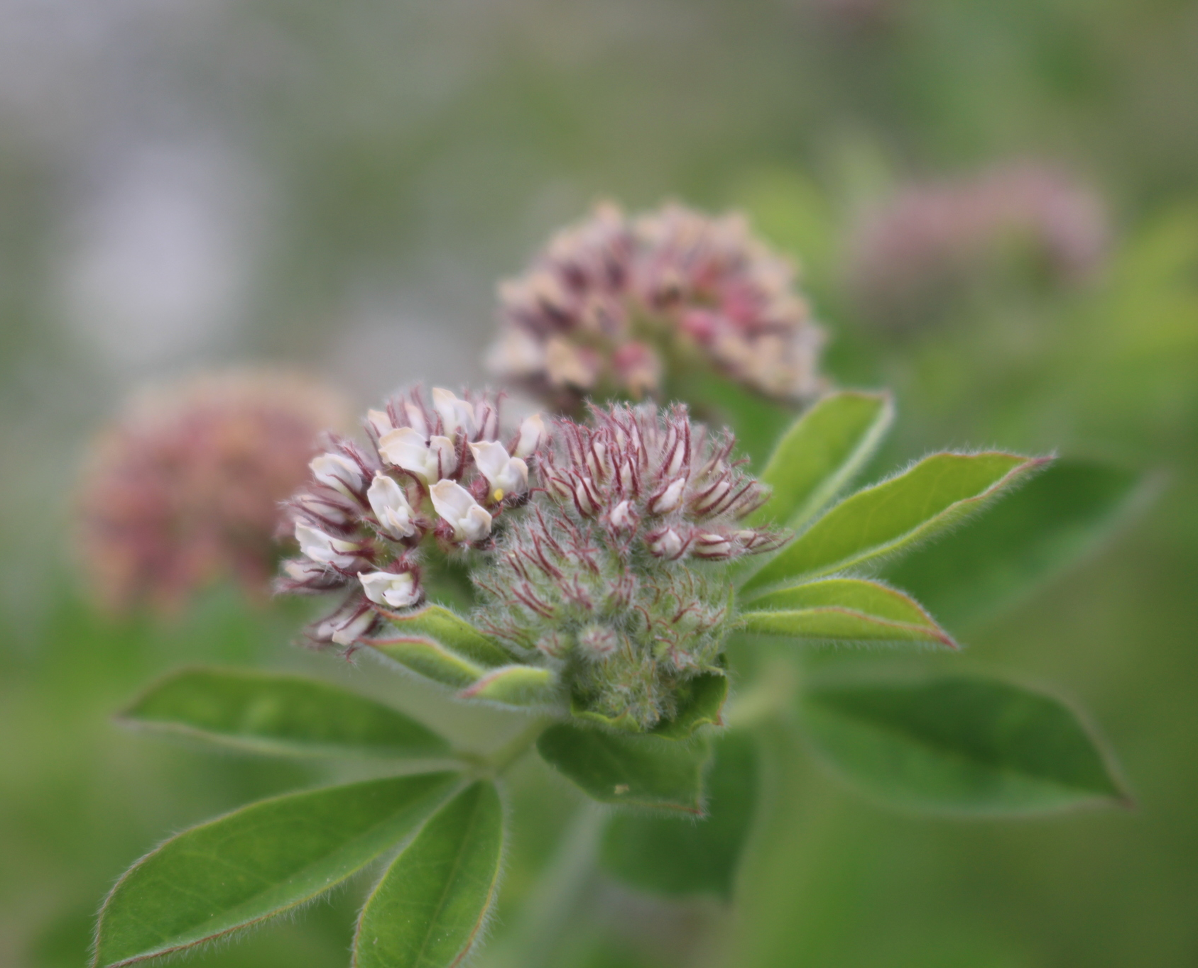
Conclusions
L. rectus Tas2206 was most receptive to M. australicum BR1-1-5xICEMlSym symbiosis, whereas L. australis ID#3 and L. uliginosus GLOC005 displayed little-to-no success
Despite the presence of nodules & bumps, no significant nitrogen fixation (no change in Lotus species biomass)
L. rectus Tas2206 appears to be the most promising candidate with which to pursue the M. australicum BR1-1-5xICEMlSym evolutionary experiment.
A photograph of a flowering L. rectus. Image credit: Fabien Piednoir (KnowYourWeeds)
Isaak Salami, 46625143

Slide 11
References
Oldroyd, G. E. D. Speak, friend, and enter: signalling systems that promote beneficial symbiotic associations in plants. Nat. Rev. Microbiol. 11, 252–263 (2013).
Johnson, C. M. & Grossman, A. D. Integrative and Conjugative Elements (ICEs): What They Do and How They Work. Annu. Rev. Genet. 49, 577–601 (2015).
Colombi, E. et al. Population genomics of Australian indigenous Mesorhizobium reveals diverse nonsymbiotic genospecies capable of nitrogen-fixing symbioses following horizontal gene transfer. Microb. Genomics 9, 000918 (2023).
Isaak Salami, 46625143

